Slide 1
NETWORKING CONCEPTS
Wide Area Networks (WANs)
PPP, HDLC,X25,Frame Relay

Slide 2
Wide Area Networks (WANs)
Wide Area Networks (WANs): A communications system used to interconnect geographically remote computer systems.
WANs can be
  Private networks: The switching and communications equipment is owned by an organization
  Public networks: The switching and communications equipment is leased from a regulated carrier.
Because of the distances involved, the LAN/MAN technologies can not be applicable and switching is used.
Switching: The act of activating links to form a path through a network.

Slide 3
WIDE AREA NETWORKS
WANs are generally grouped into three separate connection types:
• Point-to-Point technologies
• Circuit-switched technologies
• Packet-switched technologies

Slide 4

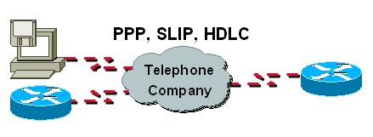
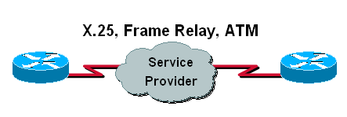
Data-Link Protocols for WAN Links
Popular WAN data-link protocols
  Serial Line Internet Protocol (SLIP)
  High-Level Data Link Control (HDLC)
  Point-to-Point Protocol (PPP)
Leased line
Circuit-switched
Packet-switched

Slide 5
WAN Encapsulation Protocols
On each WAN connection, data is encapsulated into frames before crossing the WAN link.
To ensure that the correct protocol is used, you need to configure the appropriate Layer 2 encapsulation type.
The choice of protocol depends on the WAN technology and the communicating equipment. The more common WAN protocols are;
HDLC, PPP, X.25, Frame Relay, ATM

Slide 6
Point-to-Point
Point-to-Point technologies (often called dedicated or leased lines) are usually the most expensive form of WAN technology. Point-to-Point
technologies are leased from a service provider, and provide guaranteed bandwidth from location to another (hence point-to-point).
Cost is determined by the distance of the connection, and the amount of bandwidth allocated.

Slide 7
Point-to-Point
Point-to-point links require no call-setup, and the connection is usually always on. Examples of point-to-point technologies include:
T1 lines
T3 lines
E1 lines

Slide 8
Point to Point Protocol
  If two devices are directly connected to each other, then they are said to be in point-to-point configuration, and a link connecting two devices is called point-to-point link.
  Point-to-point protocol is a data link layer protocol that operates over a point-to-point link.
PPP over the Internet
  Today, millions of Internet users who need to connect their home PCs to the Internet use PPP.
  The Internet needs a PPP for a variety of purposes, including router-to-router traffic (leased line) and home-user to ISP (dial-up) traffic.
  Majority of users have a traditional modem, DSL modem or a cable modem which connects them to the Internet through a Telephone line or a TV cable connection.
  The telephone line or the cable tv connection provides a physical link, but to control and manage the transfer of data, there is a need of PPP

Slide 9
PPP Features/Services
Main services of PPP include:
  Encapsulation/Framing
  Error detection and Correction
  Support Multiple Network Layer Protocols
  Authentication
  Link Establishment, Termination, and Maintenance
Link Establishment, Termination, and Maintenance
    PPP defines how two devices can negotiate the establishment of a link, the exchange of data, and termination of a link.

Slide 10
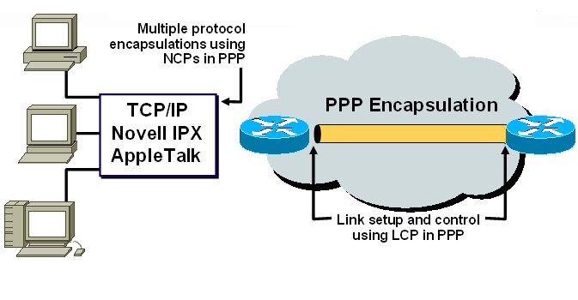
PPP Services…
Encapsulation/Framing
  The PPP protocol take a network layer packet and
  Encapsulate it within the PPP data link layer frame such that the receiver will be able to identify the start and end of the both data link frame and network layer packet within the frame.

Slide 11
PPP Services…
Error Detection and Correction
  All data link protocols like PPP and HDLC perform error detection.
  All these protocols use a field in the trailer usually called frame check sequence (FCS),
  FCS verifies whether bit errors occurred during transmission of the frame, if so frame is discarded.
  Error recovery is the process that causes retransmission of lost or erred frames.
  PPP can perform error correction but by default it is not enabled.

Slide 12
PPP Services…
Support Multiple Network Layer Protocols
  PPP supports multiple protocol suites like TCP/IP (IP), Novell’s (IPX), Appletalk e.t.c running over same physical link at the same time.
  PPP multiplex different network layer protocols over a single point-to-point connection
Authentication
  PPP defines how two devices can authenticate each other.
  PPP is designed for use over dial-up links where verification of user identify is necessary.
  Authentication means validating the identity of a user who needs to access a set of resources

Slide 13
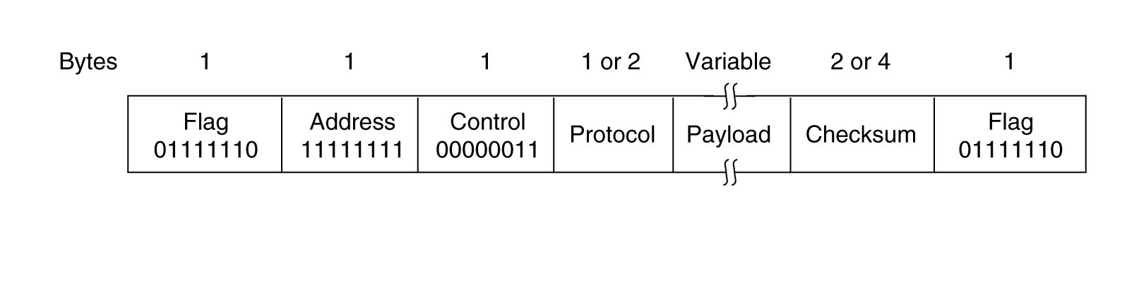
PPP Frame Format
The PPP frame consists of the following fields:
  Flag
  Address
  Control
  Protocol
  Data
  FCS
  Flag

Slide 14
PPP Frame Format…
Flag
  One byte field
  It identifies the start and end of the PPP frame
  Contains the binary sequence: 0111 1110
Address
  One byte field
  As the PPP is used for point-to-point connections, not for multipoint connections like LANs, it does not assign individual station addresses
  Uses the standard broadcast address value to avoid data link layer addressing (MAC)
  It uses the fixed binary sequence: 1111 1111

Slide 15
PPP Frame Format…
Control
  One byte field
  The control field uses the format of the U-frame in HDLC
  It uses the fixed binary sequence:
  it shows that the frame does not contain any sequence numbers and that there is no flow and error control.

Slide 16
PPP Frame Format…
protocol
  Two byte field
  The protocol field defines what is being carried in the data field.
  Whether the PPP frame carries user data or other information
  In this field different codes are defined to identify different protocols
  It indicates the protocol encapsulated in the data field of PPP frame e.g.
    LCP
    Authentication protocol
    NCP
  Thus PPP is a multi-protocol framing method suitable for use over modems

Slide 17
PPP Frame Format…
Data
  Maximum 1500 bytes
  This field carries either the user data or other control information
FCS
  2 byte or 4 byte field
  Used for error detection using CRC code

Slide 18
High Level Data Link Control (HDLC)
Bit-oriented data link control
Derived from IBM Synchronous Data Link Control (SDLC)
Related to Link Access Procedure Balanced (LAPB)
  LAPD in ISDN
  LAPM in cellular telephone signaling

Slide 19
HDLC Data Transfer Modes
Normal Response Mode
  Used in polling multidrop lines
  Unbalanced config where a single primary station has control over operation of one or more secondary stations.
  Frames transmitted by primary are called commands and those transmitted by secondary are called responses
Commands
Primary
Responses
Secondary
Secondary
Secondary

Slide 20
HDLC Data Transfer Modes
Asynchronous Balanced Mode
  Used in full-duplex point-to-point links
  Nodes at each end of link have equal status
  Are called combined stations and can transmit both commands and responses
Primary
Commands
Responses
Secondary
Secondary
Responses
Commands
Primary

Slide 21
HDLC Frame Format
Flag
Address
Control
Information
FCS
Flag
Control field gives HDLC its functionality
Codes in fields have specific meanings and uses
  Flag: delineate frame boundaries
  Address: identify secondary station (1 or more octets)
    In ABM mode, a station can act as primary or secondary so address changes accordingly
  Control: purpose & functions of frame (1 or 2 octets)
  Information- distinguished by first bit i.e. bin ‘1’, used to facilitate flow control
  Supervisory frame- The first two bits will be bin ‘10’, used as acknowledgments for flow control
  Unnumbered- do not contain any sequence numbers, and are used for various control functions
  Information: contains user data; length not standardized, but implementations impose maximum
  Frame Check Sequence: 16- or 32-bit CRC

Slide 22
HDLC vs. PPP
High Level Data Link Control Protocol
  It is both point to point and multipoint protocol
  It delivers data on synchronous links only
  It provides error detection but does not provide error correction
  It does not have protocol type field, so it does not support multiple protocols
Point to Point Protocol
  It point to point protocol
  It delivers data on both synchronous and asynchronous links
  It provides both error detection and error correction
  It has a protocol type field so it supports multiple protocols

Slide 23
Conclusion
The most significant advantage PPP can offer is the automatic login and configuration negotiation at the start of connection
With these features, your PPP software only needs to know your login userid/password and the telephone number of your service provider.
The software can then dial-up into your service provider and figure out everything else on its own.

Slide 24
Circuit Switching
Circuit-Switched technologies require call-setup to occur before information can be transferred. The session is usually torn down once data transfer is complete (this is identified as an On-Demand Circuit
Circuit-Switched implies that there is a dedicated communication path between two stations.
The path is a connected sequence of links between nodes (switching stations).
On each physical link a channel is dedicated to the connection
Steps in Circuit Switching; Circuit establishment, Information transfer, Circuit disconnection
  Examples of circuit-switched technologies include: Dial-up, ISDN, ATM

Slide 25
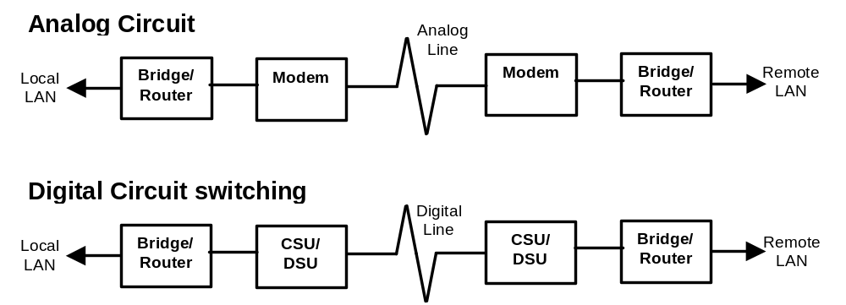
Circuit Switching

Slide 26
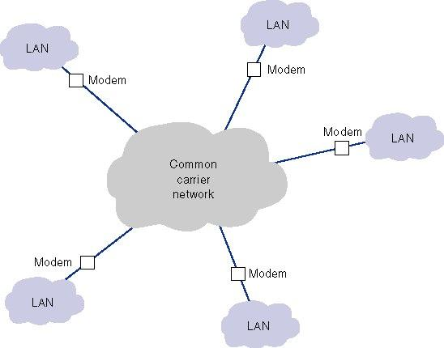
Circuit Switched Services

Slide 27
Advantages and Disadvantages of Circuit Switched Services
The advantages of circuit switched networks
  they are simple,
  flexible, and
  inexpensive when not used intensively.
The main limitations with dialed circuits are.
  Each connection goes through the regular telephone network on a different circuit, which vary in quality.
  Data transmission rates are low, from 28.8 to 56 Kbps.
  Call set-up delay
  Inefficient
  Fixed data rate

Slide 28
Packet-Switched
Packet-Switched technologies share a common infrastructure between all the provider’s subscribers. Thus, bandwidth is not guaranteed, but is instead allocated on a best effort basis.
Packet-switched technologies are ill-suited for applications that require consistent bandwidth, but are considerably less expensive than dedicated point-to-point lines.
Examples of packet-switched technologies include: Frame-Relay, X25

Slide 29
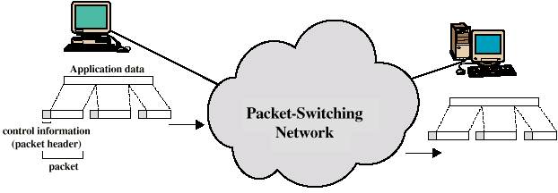
Packet Switching Technique
Stations break a long message into packets
Packets sent one at a time to the network
Packets handled in two ways
  Datagram (Connectionless)
  Virtual circuit (Connection-oriented)

Slide 30
Datagram
Each packet treated independently
Packets can take any practical route
Packets may arrive out of order- must have a sequence number in pkt header
Packets may go missing
Up to receiver to re-order packets and recover from missing packets

Slide 31
Virtual Circuit
Preplanned route established before any packets sent
Call request and call accept packets establish connection (handshake)
Each packet contains a virtual circuit identifier instead of destination address
No routing decisions required for each packet
Not a dedicated path
Two types of virtual circuits are available from common carriers,
  Switched (SVC)- temporary, maintained for duration of call
  Permanent (PVCs) – permanent and always present PVCs are far more common.

Slide 32
Permanent and Switched Virtual Circuits
Although established using software, setting up or taking down a PVC takes days or weeks to do.
Each PVC has two data rates:
  a committed information rate (CIR), which is guaranteed
  a maximum allowable rate (MAR), which sends data only when the extra capacity is available.
Packets sent at rates exceeding the CIR are marked discard eligible (DE), and discarded if the network becomes overloaded, in which case they may need to be retransmitted.

Slide 33
Virtual Circuit vs Datagram
Virtual circuits
  Network can provide sequencing and error control
  Packets are forwarded more quickly
    No routing decisions to make
  Less reliable
    Loss of a node looses all circuits through that node
Datagram
  No call setup phase
    Better if few packets
  More flexible
    Routing can be used to avoid congested parts of the network

Slide 34
Advantages of packet switching
Line efficiency
  Single node to node link can be shared by many packets over time
  Packets queued and transmitted as fast as possible
Data rate conversion
  Each station connects to the local node at its own speed
  Nodes buffer data if required to equalize rates
Packets are accepted even when network is busy
  Delivery may slow down
Priorities can be used

Slide 35
Connectionless vs. Connection-Oriented Packet Switched Network
 | Overhead | Greatest Strength | Call set-up | Addressing | Other Names | Virtual Circuit | Error Correction | Flow Control
Connectionless | Less | Ability to dynamically reroute data | None | Global | Datagram unreliable | None | Left to end-user devices | Left to end-user devices
Connection-oriented | More | Reliability | Yes | Local logical channel number | Reliable Virtual circuit | Created for each call, virtual circuit table established | By Virtual Circuit | By Virtual Circuit

Slide 36
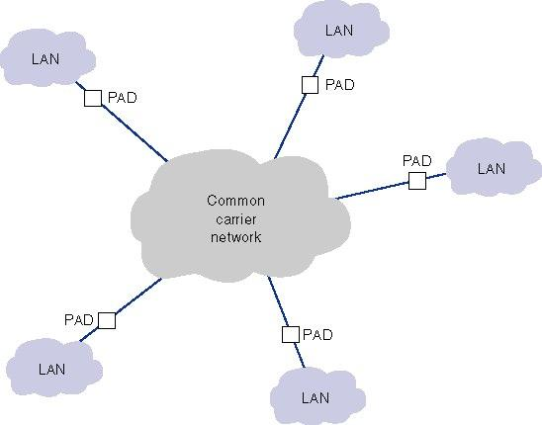
Packet Switched Services

Slide 37
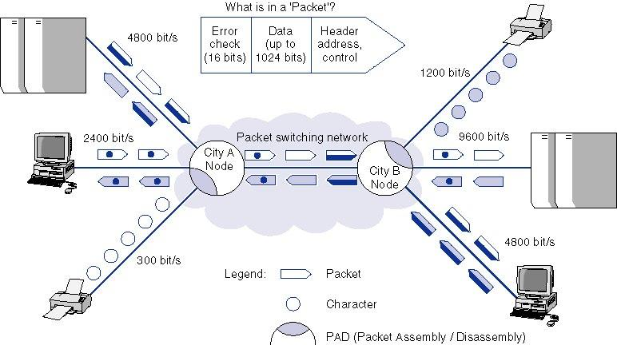
Packet Switching

Slide 38
NETWORKING CONCEPTS
Packet Switched Networks – X.25 and Frame Relay

Slide 39
X.25 Protocol
Approved by ITU in 1976
WAN protocol using packet switching technologies
Allows computers on different public networks to communicate through a Public Switched Data Network (PSDN).
Small packets are routed through a network based on destination address contained within each packet.

Slide 40
X.25 Operation
Data is funneled into data packets that are transmitted over the network.
The packet contains
  Protocol information
    Establishes the setup
    Governs the flow of data
    Releases the connection
  Data
The network allows users to setup calls using standardized addresses.
Calls are established over virtual circuits (logical).

Slide 41
X.25 Connections
The connection is made as follows
  The source DTE specifies the VC to be used (in the packet headers) and sends the packets to a locally connected DCE.
  The local DCE examines the packet header to determine the VC to use and sends the packet to the closest PSE.
  The PSE passes the traffic to the next intermediate node or the remote DCE device.
  The DCE examines the packet header and determines the address.

Slide 42
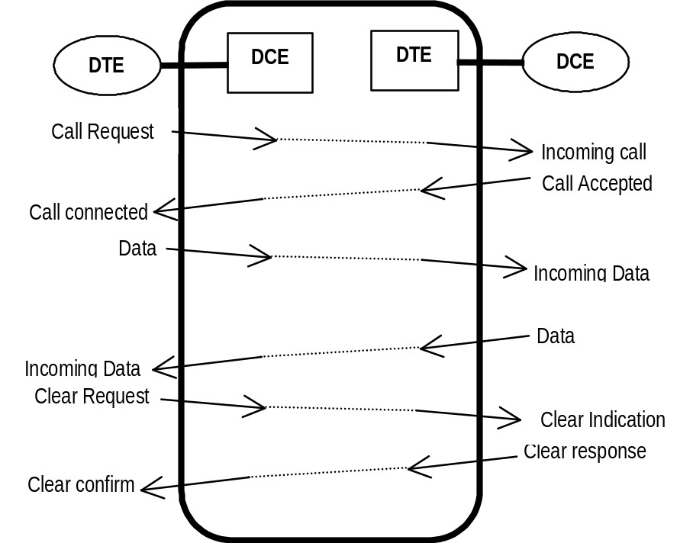
X.25 call set-up
All communication in X.25 network is done through control packets.
The communication is full duplex

Slide 43
X.25 and OSI Protocol Model
X.25 protocols maps to three lower layers of OSI reference model
  Physical Layer (Layer 1)
    Supports X.21 bis used to define electrical and mechanical procedures for using physical media
    Bit stuffing; Sending end ensures it doesn’t send string of six bin 1’s unless it’s a flag. if pattern of six bin 1’s appears in data stream then sending end inserts bin ‘0’ after fifth ‘1’ bit. At the receiver sixth bin ‘0’ is automatically discarded
  Data Link Layer (Layer 2)
    Uses LAPB to manage communication and packet framing between DTE and DCE devices
  Network Layer (Layer 3)
    Uses PLP for managing packet exchange between DTE devices across virtual circuits
    PLP uses X.121 addressing scheme to set up virtual cct

Slide 44
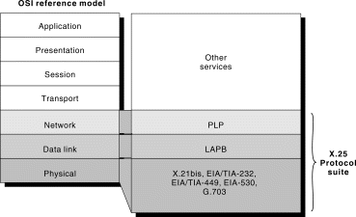
X.25 and OSI Comparison

Slide 45
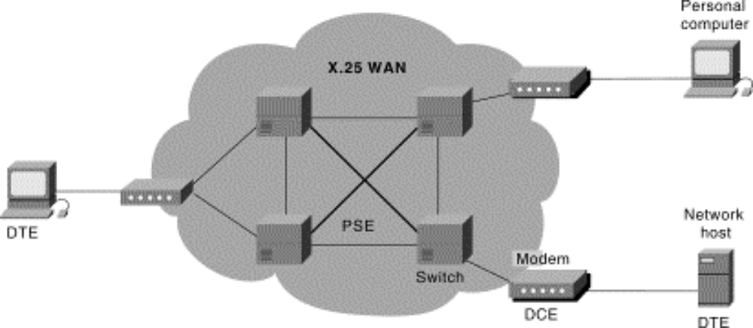
Functions of X.25 Network
Packet Switching Exchanges (PSEs)
  Switches located throughout carrier’s network
  Transfer data from one DTE device to another
  Perform packet-handling functions
  Use computers with special software to provide subscriber and line connections

Slide 46
Packet Assembler/Disassembler (PAD)
Provides buffering, packet assembly and packet disassembly
Buffers (holds) data packets until PAD device can process it
PAD accepts synchronous characters and places them into proper length packets
PAD assembles outgoing data into packets forwards them to modem, multiplexer or CSU/DSU device
PAD disassembles and translates packets to proper characters at destination

Slide 47
Logical Channels
Precise channel numbers and channel group numbers are assigned when data is transferred over X.25
For use by all packets included in a data transfer
Logical Channel Identifier (LCI) or Logical Channel Number (LCN) identifies destination for each packet
LCI establishes routes to use for each packet to destination address
Channels are divided into 16 groups.
  Each group contains 256 channels, for a total of 4096 channels

Slide 48
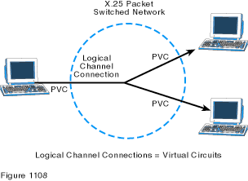
Logical Channels

Slide 49
Virtual Circuits Used by X.25
Switched Virtual Circuit (SVC)
  A temporary virtual circuit established and maintained only for duration of a data transfer session
  Shared pool of logical circuits is used to support connections
Permanent Virtual Circuit (PVC)
  Continuously dedicated virtual circuit
  Logical connection is established permanently and is always present.
  PVCs do not require sessions to be established and terminated

Slide 50
X.25 Benefits
Data can be sent to more than one receiver at same time
Communication enabled between terminals with different interfaces and transfer rates
Error-free environment for transmission of all types
Fast throughput and excellent response times
Dial-up and dedicated port options
Up to 1,024 simultaneous logical channels per link
Reliable connection over copper lines
Speed range of 9.6 Kbps. to 2 Mbps

Slide 51
X.25 Applications
Electronic funds transfer
Airline Reservations
Retail point of sale and Remote order entry
Information retrieval in databases and File transfer
E-mail
Automatic teller machines and card-operated gasoline pumps

Slide 52
Fast Packet Switching
Generic name for later high speed WAN and MAN services.
Developed because of demand for higher speed transmission across WANs due to
  The change from primarily text to graphics interaction.
  The increase in ‘’bursty’’ traffic application
  Intelligent end-user devices (PCs, workstations, X-windows terminals) with increased computing power.
  The proliferation of LANs and client / server computing.
  Widespread digital networks
Fast Packet Switching: The act of forwarding a frame while still receiving it.

Slide 53
Fast Packet Switching
A technique of reducing nodal processing by assuming that the frame is likely to be correct and to start passing on the frame as soon as the destination address is recognized.
Due to the high data rates expected in fast packet switching, the issue of nodal congestion arises.
The new concept in flow control has two approaches
  Ease congestion by discarding low priority data.
  Employ some flow control by reducing incoming data.

Slide 54
Congestion
LANs regulate access to the network by Medium Access Protocols (MAC protocols)
  CSMA/CD and CSMA/CA.
  Token Passing.
WANs do not use MAC protocols hence congestion becomes an important issue.
Methods have to be designed to deal with congestion hence the use of congestion control techniques

Slide 55
Error correction
A node cannot detect bit errors until the entire frame has been received.
In fast packet switching by the time the node knows about the error most of the frame has already been forwarded into the next node.
There are two ways of dealing with errors
  The node that detects the error immediately aborts the transmission. Downstream nodes, interrupt transmission of this frame and eventually the frame disappears from the network.
  At the destination the higher layers will ask the original transmitter to retransmit the frame.

Slide 56
Frame Relay
Like X.25 it is an access protocol to a packet switched WAN.
Frame relay is a data link protocol at the ISO layer 2 level which defines how frames of data are assembled and rapidly routed through a packet network.
It uses a variable size frame.
It supports all types of congestion control
It is deal for ‘’bursty’’ traffic at data rates of up to 34/45 Mbps.

Slide 57
Frame Relay
Its typical application is provision of a seamless interface (invisible to the end users) between several LANs and a WAN.
It provides error detection but not error correction, relying on higher layers to initiate automatic retransmission on request (ARQ).
In frame relay, packets are routed through one or more virtual circuits known as Data Link Connection Identifiers (DLCI).
It supports two types of connection i.e. PVCs and SVCs.

Slide 58
Frame Relay
Designed to offer higher speed data transmission for long distance networks at reasonable costs
Designed as fast packet service to replace X.25
Has a low incidence of error or data loss because it was designed to use fiber-optic media
Notes:
Frame does not do error checking; it relies on upper protocols to do so.

Slide 59
Frame Relay Benefits
Simplified form of packet switching
Reduces cost of transmission facilities and equipment
Offers high speed connectivity and reduced transmission delays and supports high bandwidth applications
Provides increased performance, reliability and application response time
Greater efficiency for distributed networks
Increases interoperability through well-defined international standards

Slide 60
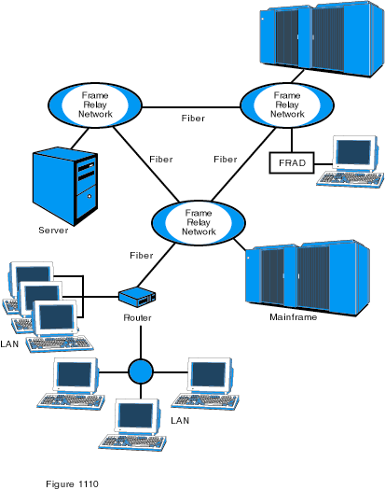
Frame Relay Network

Slide 61
X.25 vs. Frame Relay
X.25 designed for lower quality lines
  Require more error checking procedures to ensure integrity of data
  Does error checking at each router hop
Frame Relay eliminated all error recovery procedures
  Does not check for errors at each router hop
  Relies on network and transport protocols to perform retransmission and error recovery
Notes:
Point out that Frame relies on network and transport protocols to perform retransmission and error recovery

Slide 62
Frame Relay Capacity & Costs
Committed Information Rate (CIR) CIR =B_{C}/T
  Specifies the guaranteed data rate between two frame relay terminals connected by a frame relay network.
Committed burst size (B_{C})
  Definition: The maximum amount of data (in bits) that the network agrees to transfer, under normal conditions, during a time interval Tc.
Burst excess (Be)
  Definition: The maximum amount of uncommitted data (in bits) in excess of Committed Burst Size (Bc) that a frame relay network can attempt to deliver during a Committed Rate Measurement Interval (Tc).
  Excess information rate (EIR)- Agreed sustainable information rate in excess of CIR that the network will accommodate if there is sufficient bandwidth
  (EIR) = Be/T

Slide 63
Frame Relay Capacity & Costs
Example
A customer agrees an SLA with a frame provider. The agreed committed information rate is 256 Kbps and committed burst size is 6144 bytes. If network resources allow, the customer can burst for a further 2048 bytes. Determine the excess information rate.
CIR =B_{C}/T, find T, (EIR) = Be/T

Slide 64
Frame Relay Capacity & Costs
Example 2
A customer agrees an SLA with a frame relay network provider. The CIR is 512 kbps, the EIR is 132 kbps and the committed burst size is 6144 bytes. Calculate the excess burst size.

Slide 65
Frame Relay Congestion and Flow Control
Congestion
  Uses of Explicit and Implicit congestion control.
Flow Control
  Uses discard of frames when errors or congestion occurs
  Some frames are discarded, even without errors if congestion occurs.
  When signing a contract to use the network, a guaranteed data rate is set.
  Frames which take rates above this will be accepted but will be the first ones to be discarded if congestion occurs.

Slide 66
Strength of Frame Relay
Its variable frame length provides a convenient interface with existing LANs & WANS. (e.g. Ethernet, X.25 etc).
It supports all types of flow control and can thus be used on a number networks.
Note
  The fast packet switching networks require a little more time to recover from bit error than traditional packet networks but the bit error rates are expected to be low so these events don't occur frequently.

